Slide 1

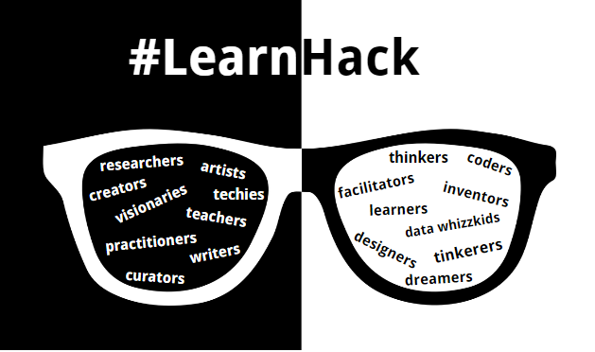

E-LabNote
Taking notes at next level

Slide 2


Slide 3
WHAT WE HAVE BUILT
Include necessary database
Track my experiment
Sync button, import, export
Share my note to supervisors
https://phantira29.wixsite.com/e-labnote/database

Slide 4
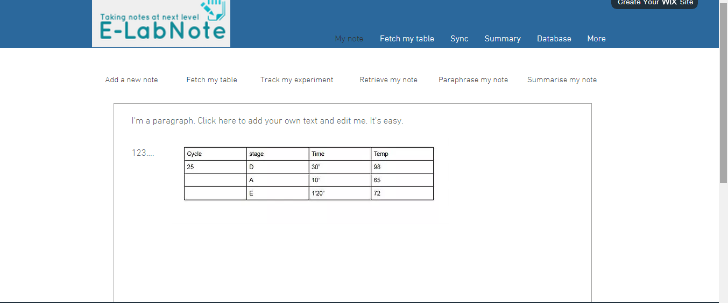
PROTOTYPE SNAPSHOTS

Slide 5
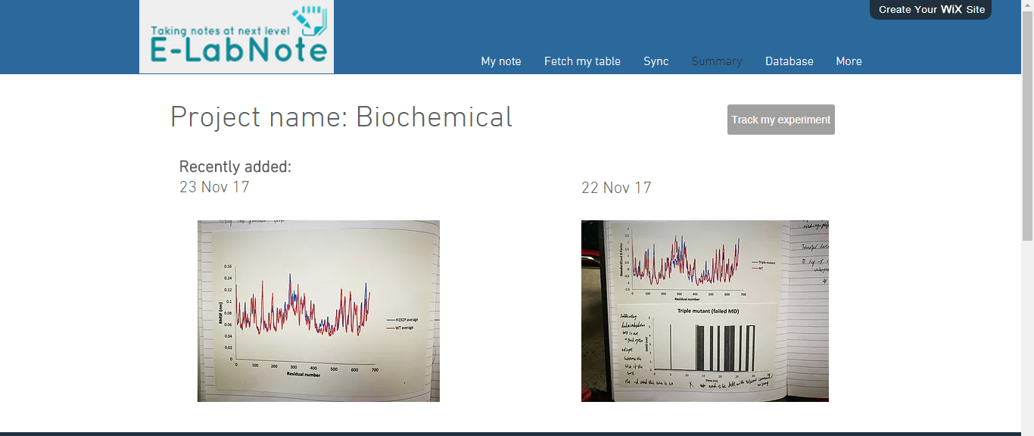

Slide 6
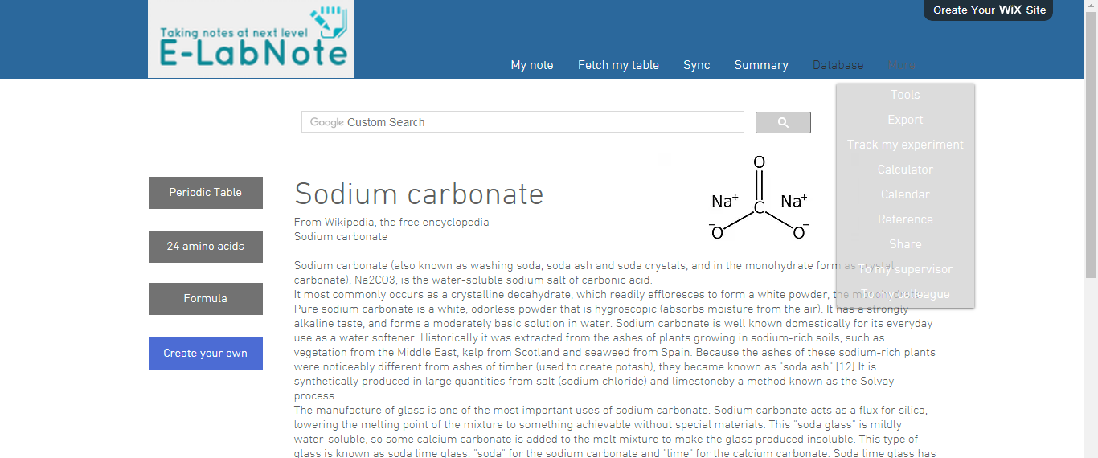

Slide 7
LIVE DEMO!!

Slide 8
WHAT WE COULD DO
Image processing via OCR
Audio recording
Search options
Add ons
Open source package development by user

Slide 9
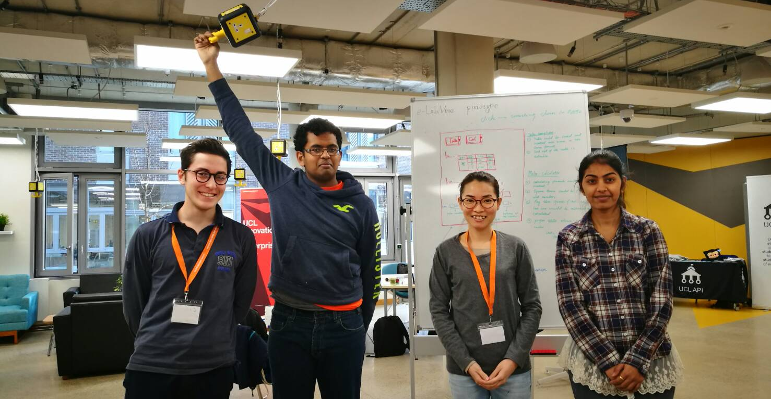
Team members
Carlo Immanuel Phantira Supriya
Programmer Tester UX/UI developer Prototyper

